Slide 1


Donkey Games
Sales Analysis

Slide 2
TABLE OF CONTENTS
HISTORY
GENRE
DEVELOPERS
BLIND SPOTS
FINDINGS
What games have sold in the past?
Not all games are the same!
Who does what?
Which areas need more data and further analysis
What are the conclusions of this analysis?

Slide 3
THE INDUSTRY
The sector is larger than the movie and music industry combined.
Over two billion gamers, over 25% of the world's population.
In 2020, the gaming industry generated $155 billion in revenue.
By 2025, analysts predict the revenues of over $260 billion.

Slide 4
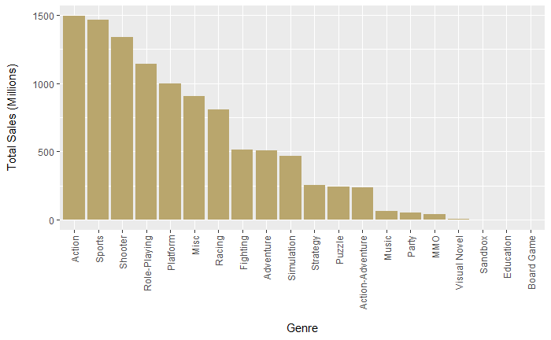
Total Sales by Genre

Slide 5
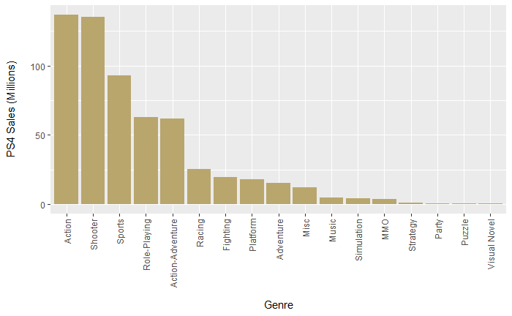
PS4 Sales by Genre

Slide 6
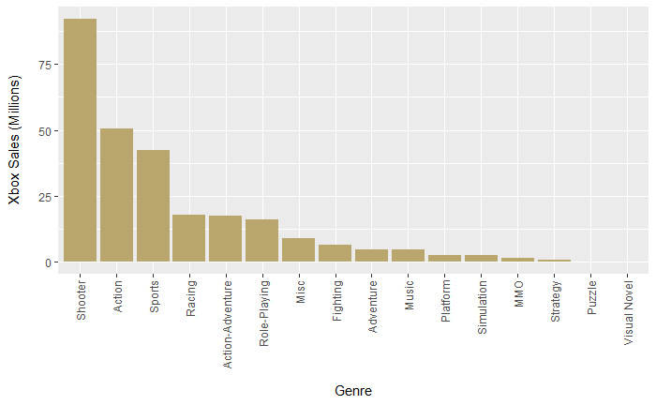
Xbox Sales by Genre

Slide 7
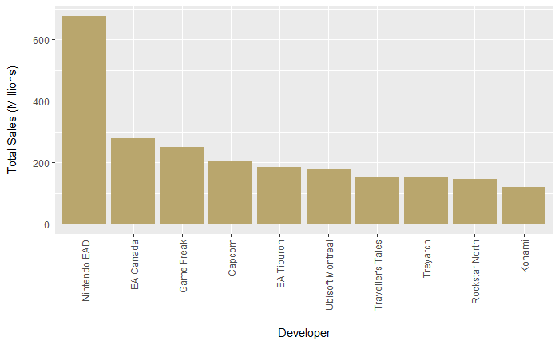
Total Sales by Developer

Slide 8
TOP 5 GENRES
GENRE | SALES (Millions) | %
Action | 1496 | 14.2
Sports | 1464 | 13.9
Shooter | 1340 | 12.7
Role- Playing | 1142 | 10.8
Platform | 1000 | 9.5

Slide 9
BLIND SPOTS
PC GAMING
VR GAMING
MOBILE GAMING
NEW MARKETS
PC Gaming is growing as the technology catches up with console gaming.
Could be a fad, or the Next Big Thing.
More & more consumers play games on their phone / tablet.
Micro – Transactions !
Emerging Markets !

Slide 10
CONCLUSIONS!
Top 5 Genres make up over 60% of sales
Investment should be in a Top 5 genre
Huge differences in Platform usage
Mobile usage needs to be investigated
Micro-Transactions need to be looked at
More data is required

